Slide 1
Machine learning prediction for classification of outcomes in local minimization
Abstract
Machine learning schemes are employed to predict which local minimum will result from local energy minimisation of random starting configurations for a triatomic cluster. The input data consists of structural information at one or more of the configurations in optimisation sequences that converge to one of four distinct local minima. The ability to make reliable predictions, in terms of the energy or other properties of interest, could save significant computational resources in sampling procedures that involve systematic geometry optimisation. Results are compared for two energy minimisation schemes, and for neural network and quadratic functions of the inputs.

Slide 2
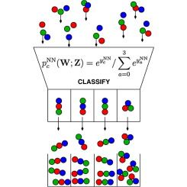
Highlights
Machine learning is used to predict which minimum will result from local minimization.
Prediction accuracy often depends on the configuration closest to convergence.
Using sequences of configurations sometimes improves the predictions.
Predictions may accelerate sampling schemes that employ systematic quenching.

Slide 3
Review Article
Small steps towards the development of chemical artificial intelligent systems
Researchers working in the field of Artificial Intelligence and human-level intelligent agents are driven by the ambitious projects of understanding the foundations and running mechanisms of the human mind, and trying to reproduce them artificially. The human nervous system is a “computational machine” based on a complex “wetware” of neuronal cells collecting, relaying, processing and storing information under the shape of electrochemical signals. It is worthwhile trying to imitate human intelligence by using chemical systems. In this review, two types of chemical artificial intelligent systems are presented the sensing and processing properties of chromogenic and fluorogenic materials

Slide 4
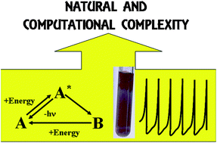
Highlights
If A receives an external perturbation, it stores energy from the outside and reaches an excited new state, A* which is unstable.
In the case of fluorogenic materials, A* will decay to the initial state A by producing light.
In the case of chromogenic compounds, the B structure is a chemical metastable state: it can convert back to A by using the thermal energy available at room T or it may need another form of energy and hence another perturbation to go back to the A state.

